Slide 1


TASK 3

Slide 2



5 content categories

Slide 3
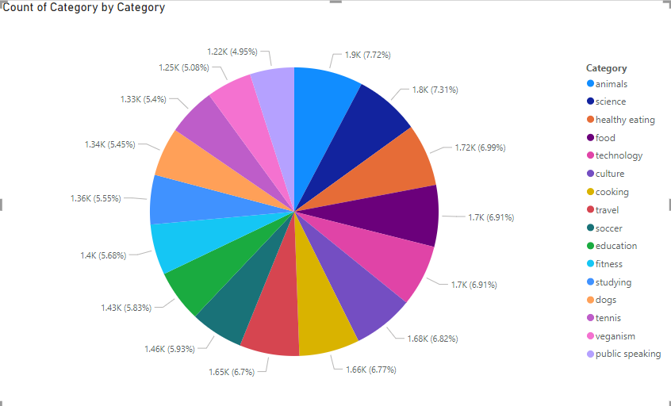
Content

Slide 4



unique categories
There are 16 unique catagories

Slide 5
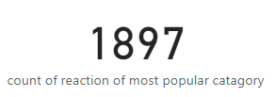
Count reactions are there to the most popular category
1897 Count reactions are there to the most popular category

Slide 6
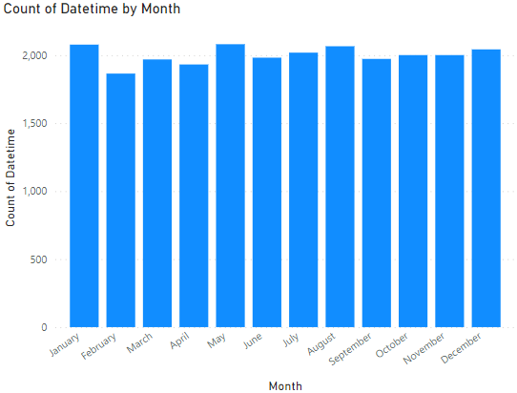
may is month with the most posts

Slide 7

Thank you!
ANY QUESTIONS?

